Slide 1
HIOS Portal Release 20.00 Issuer Training

Slide 2
Agenda
Provide an Overview of HIOS Portal Release 20 Enhancements
Outline CMS Portal UI Changes
Provide an Overview on Accessing HIOS and Requesting HIOS Roles
Provide an overview of the HIOS Portal Enhancement “Manage Data Change Requests”
Create Data Change Requests
View Data Change Requests
Email Notifications
Reference documents
Questions & Answers

Slide 3
Overview of HIOS Portal Release 20 Enhancements
https://www.REGTAP.info

Slide 4
Enhancements for April 2016 Release
List of Enhancements | Enhancement Description
Introduction of Manage Data Change Request Functionality | This enhancement provides users with Only the Company, Issuer, or Organization Administrator Roles with the capability to submit certain data change requests via the HIOS User Interface rather than logging a help desk ticket.
Enhancement to Role Management functionality | This enhancement provides the ability to request a role for multiple issuers on a single request rather than submitting one request, for each issuer.
Removal of certain roles for HPOES Module | This enhancement provides the following updates related to the HPOES module: The Roles (GUEST and AUTHORIZING OFFICIAL) are no longer available for request on the HIOS UI
Enhancement to Pending Approval Request Emails | HIOS email functionality is enhanced so that the system will now send consolidated emails twice a day (9AM and 3PM) that includes a list of all Pending approvals. The email will be sent to authorized users with HIOS Approval roles Only. The email will contain the Number of Requests pending for less than 96hrs (4 days) and more than 96hrs (4 days).
FEIN Validation Status- Tool Tip Update | A new tool tip is added to further explain the FEIN Validation status under organization information in HIOS.

Slide 5
CMS Portal Changes

Slide 6
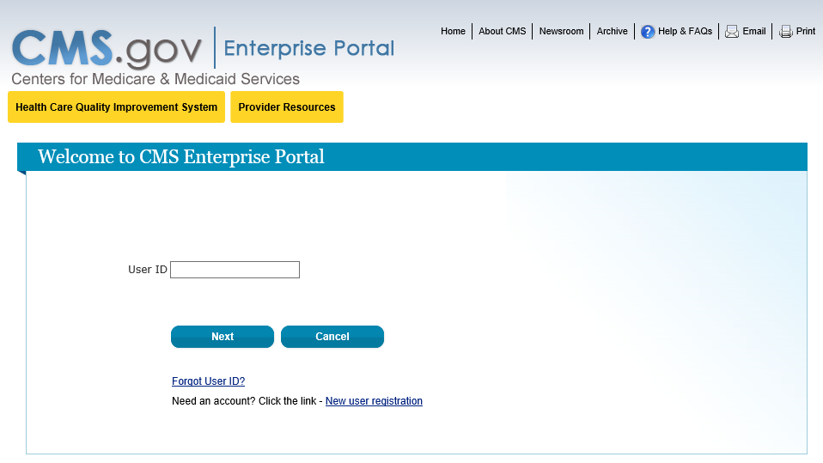
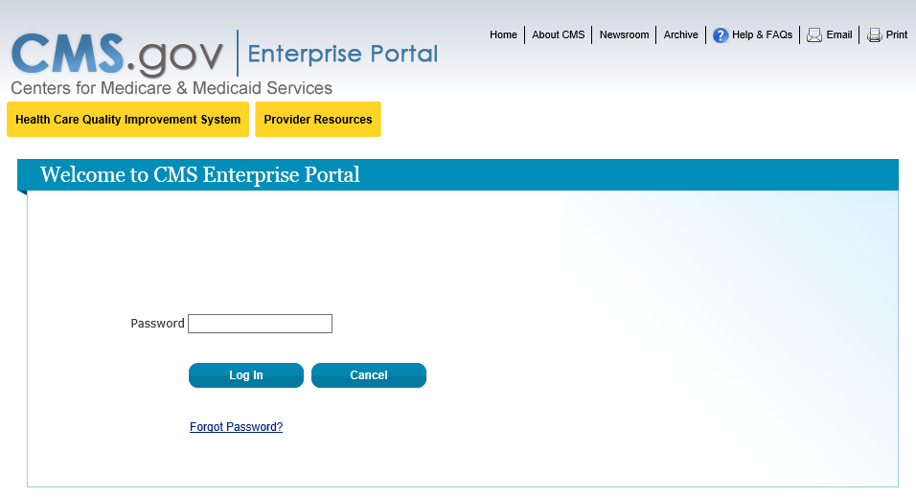
CMS Portal UI Changes
Beginning April 11, 2016 (date subject to change), HIOS Users logging into the CMS Portal (https://portal.cms.gov) will see the User ID and Password fields split into two separate screens (Figure 1 and 2 displayed). These fields were previously on the same page.
If Users encounter log-in issues on these pages or see additional screens prompting to set up a MFA device, please contact the Exchange Operations Support Center at 1-855-267-1515 or email CMS_FEPS@cms.hhs.gov and provide a screenshot to submit a ticket to the helpdesk.
Figure 1: CMS Enterprise Portal – Enter User ID
Figure 2: CMS Enterprise Portal – Enter Password

Slide 7
Accessing HIOS And Requesting User Roles

Slide 8
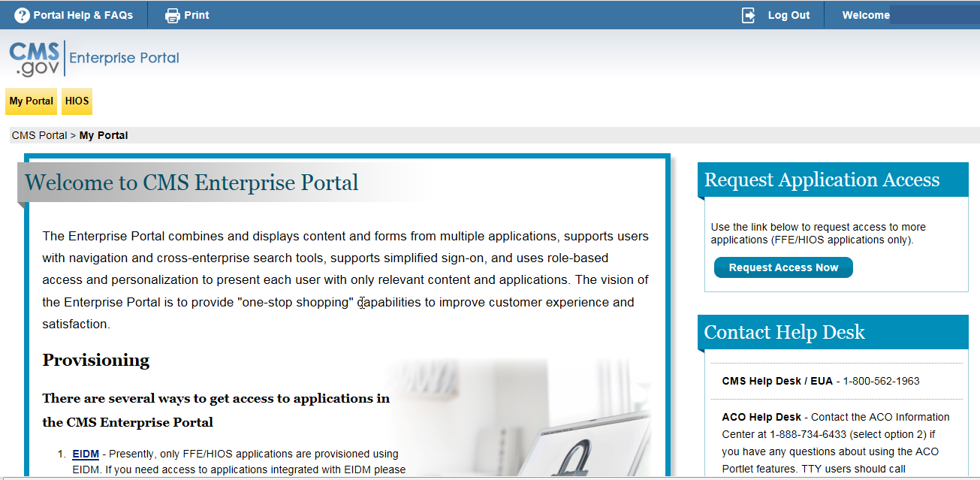
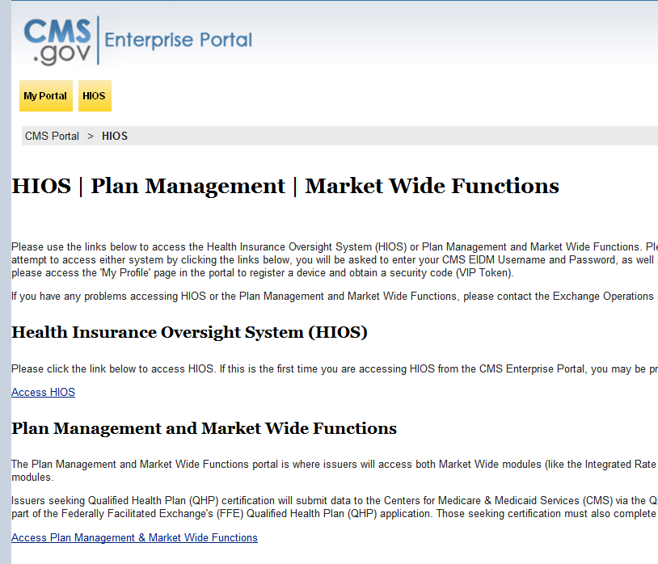
Accessing HIOS
Log into HIOS through the CMS portal(https://portal.cms.gov) using EIDM credentials.
Select the yellow HIOS tab and select the Access HIOS link on the landing page.
EIDM Portal page - Authorized HIOS Users
CMS Enterprise Portal - Access HIOS

Slide 9
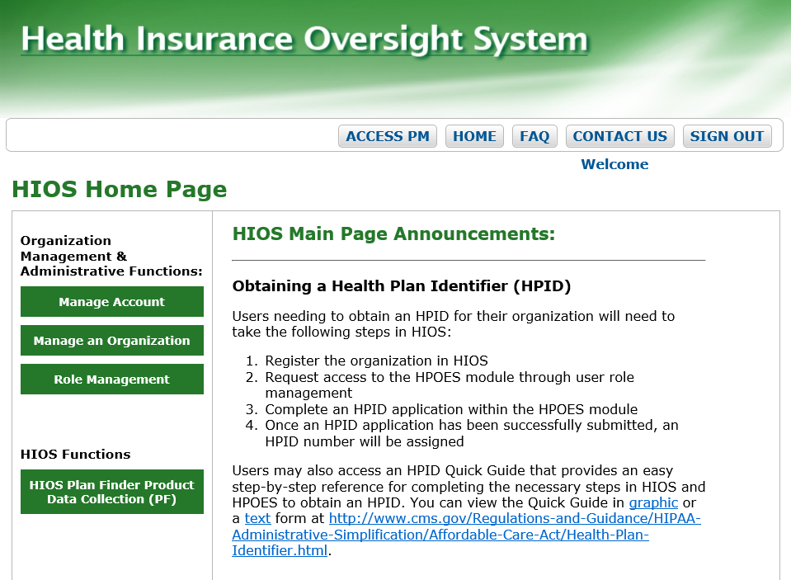
Requesting User Roles in HIOS
To access the “Manage data changes” Tab, the users should have administrator privileges for either a company, issuer, or an organization.
To request the administrator role, select the “Role Management” button on the HIOS home page.

Slide 10
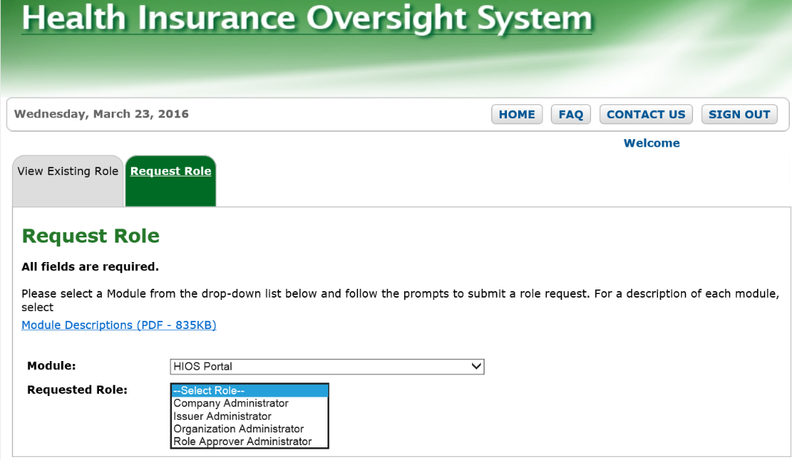
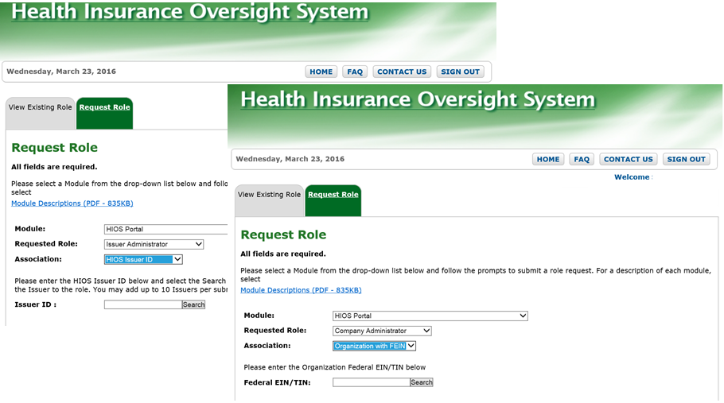
Requesting User Roles in HIOS Continued
On the Role Management tab, Navigate to the “Request Role” tab.
Select the HIOS Portal module from the drop-down menu
Users will need to enter an Issuer ID or Federal EIN/TIN to proceed with a role request submission
HIOS –Request Role

Slide 11
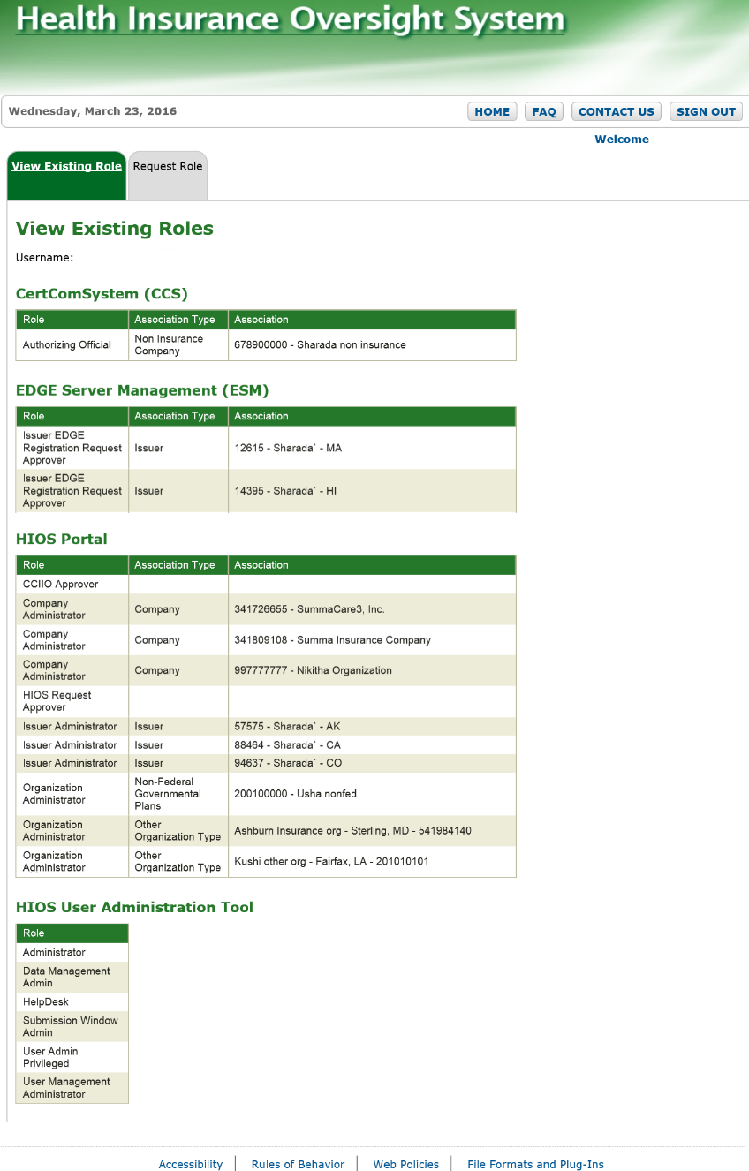
View Existing Roles
HIOS role requests will be approved in one to two business days.
Once HIOS role requests have been approved, users will see their roles and access permissions on the “View Existing Role” tab.

Slide 12
Overview of Manage Data Change Requests Functionality

Slide 13
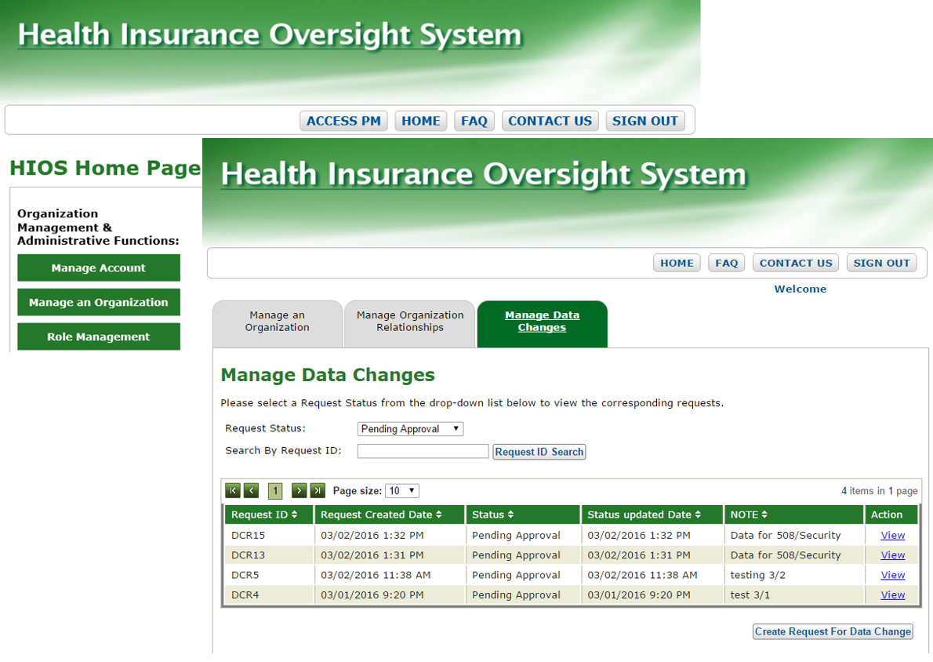
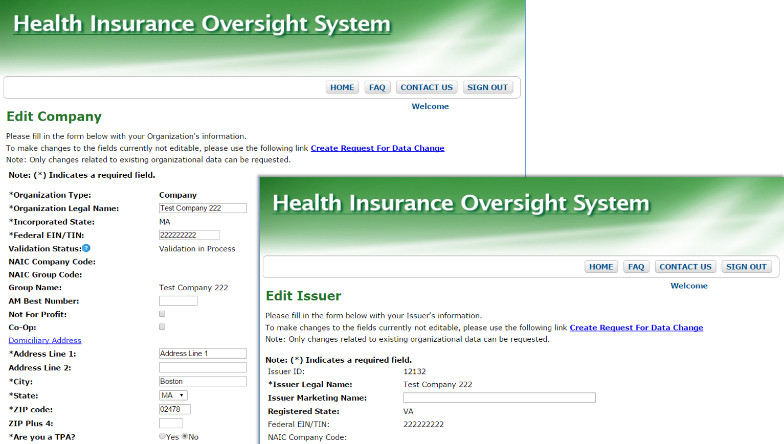
Access Manage Data Changes
Access Manage Data Changes
On the HIOS Home page, select the “Manage an Organization” button and then Select the “Manage Data Changes” tab.
Note: Administrator users can also access the Manage Data Changes page through the "Create Request for Data Change” link on the “Edit Company” and the “Edit Issuer” pages.
Administrator users can do the following on the Manage Data Changes Page.
View status of existing Data Change Requests
Create New Data Change requests
HIOS - Manage Data Changes
Edit Company/Edit Issuer – Create Request for Data Change

Slide 14
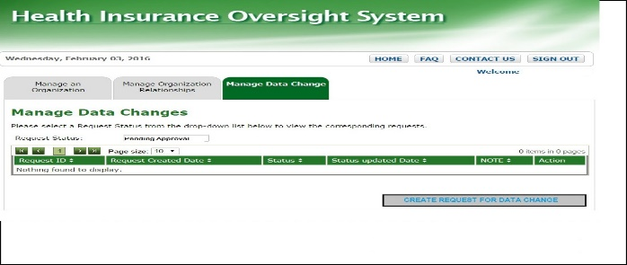
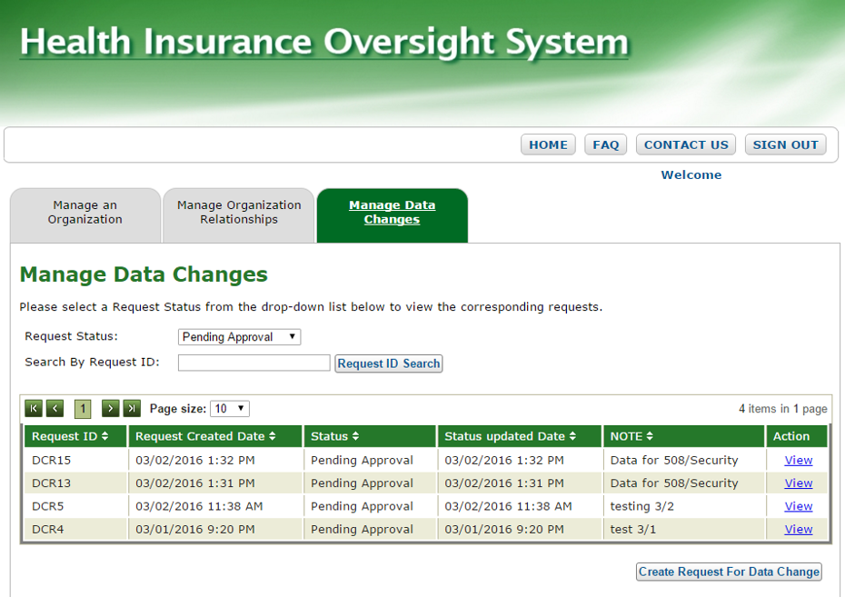
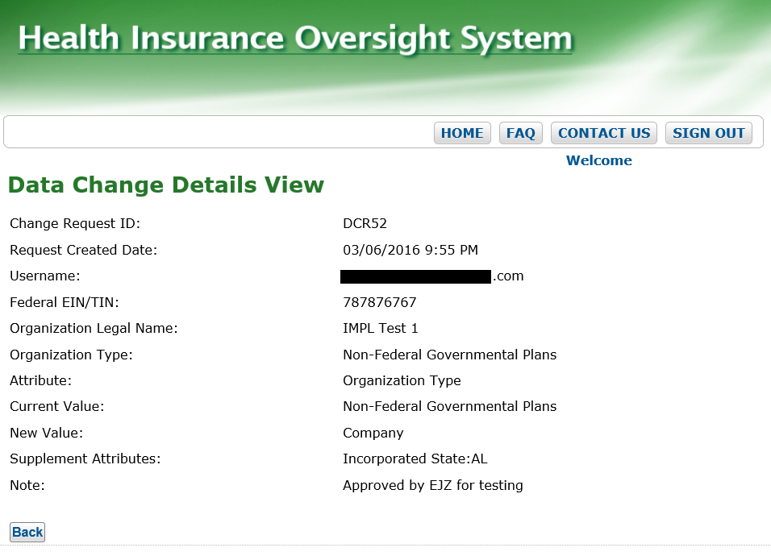
View Status of Existing Data Change Requests
Administrator users shall not see any requests pending when they login for the first time.
Company, Issuer, and Organization Administrators can view the status of their existing data change requests on the Manage Data Changes page for the following statuses.
Pending Approval (Default Status)
Approved
Denied
Unable to Process
Completed
Administrators (Company, Issuer, and Organization) can sort the change requests by clicking the arrows in the column headers
Administrators can enter a “Request ID” and click on Request ID search button to search for a particular request.
Administrators can review the change request details by clicking on “View” link of data change requests.
Manage Data Changes
Data Change Details View

Slide 15
Create Data Change Requests

Slide 16
Create Data Changes
Data change requests can be created and submitted for approval by the following:
Company administrators
Issuer Administrators
Organization Administrators
To Create Data Change Requests User can do the following:
Select the “Create Request for Data Change” button at the bottom of the Manage Data Changes page.
Manage Data Changes – Create Request for Data Change

Slide 17
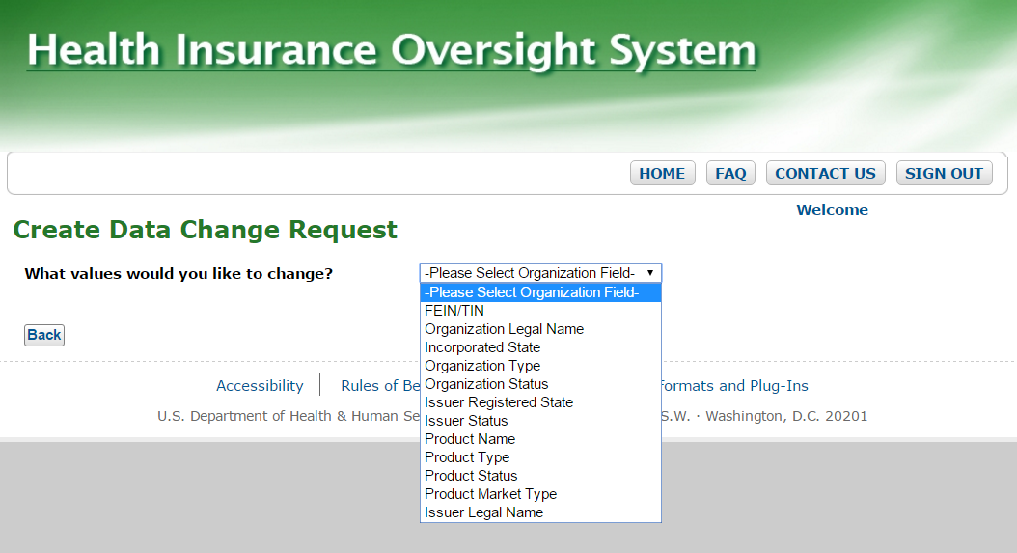
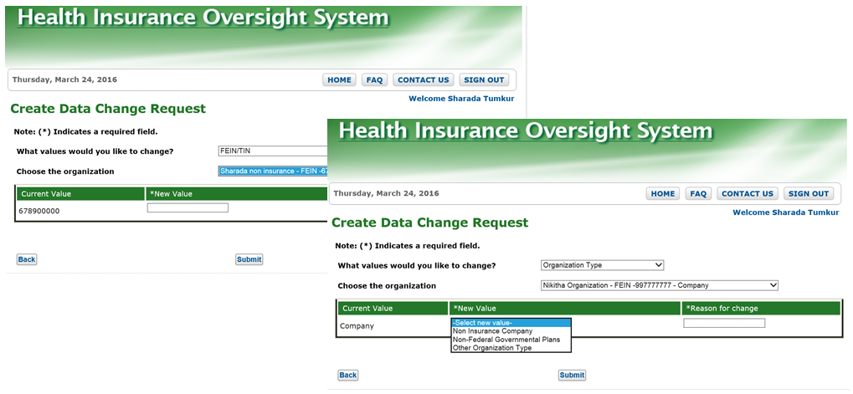
Company Administrators
Company administrators
Can submit data change requests for the following fields:
FEIN/TIN
Organization Legal Name
Incorporated State
Organization Type
Organization Status
Issuer Status
Product Name
Product Status
Product market Type
Issuer Legal Name
Depending on “what values would you like to change?” drop down selection, System will either display a text box or drop down to select the new values.
For example
FEIN/TIN: Text box
Organizational Legal Name: Text box
Organization type: Drop down
Incorporated State: Drop down
Organization Status: Drop Down
Create Data Change Request – Select Values
New Value Text box and Drop Down Fields.

Slide 18
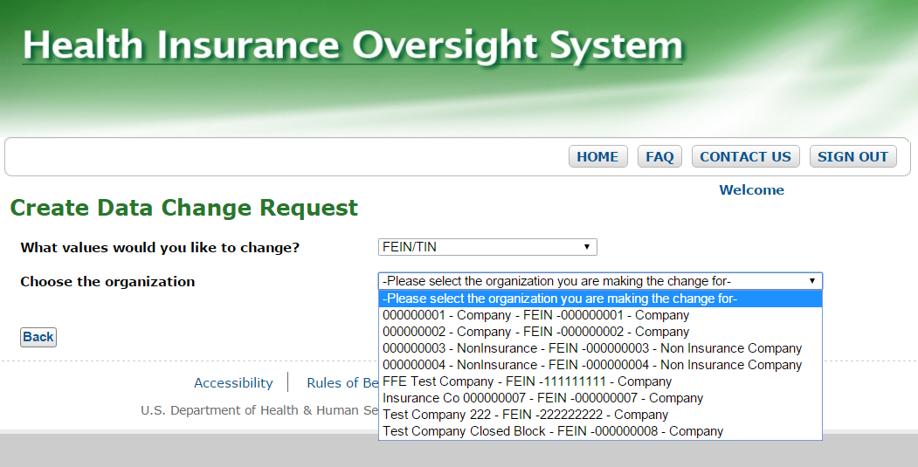
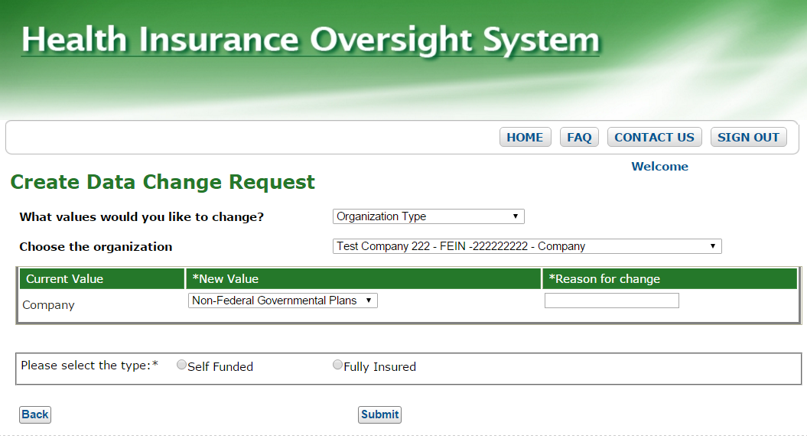
Company Administrators
Continued
If the user is a Company Administrators for multiple companies, a second drop down list shall display a list of those companies for which the data change request applies.
Note: Multiple requests must be submitted for changes to multiple organizations.
If the Company Administrator is changing the Organization type or Non Insurance Company is being changed to Non federal governmental plans, they will need to select an extra attribute for the Self funded or Fully insured radio buttons.
Create Data Change Request – Select Company
Company to Non-Federal Governmental Plans

Slide 19
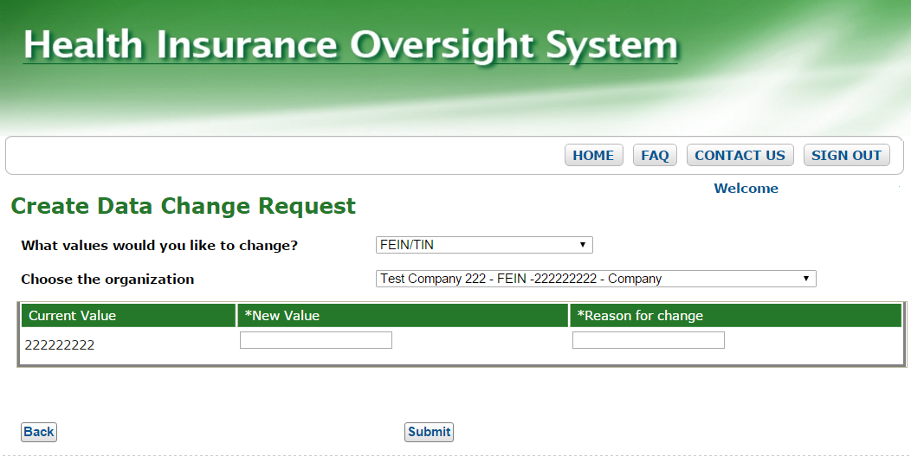
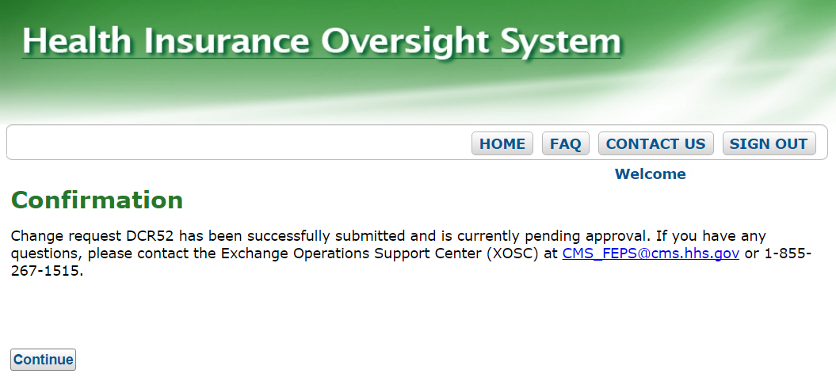
Company Administrators Continued
New Value
Is a Required field and shall display as a Drop down or Text Box based on the field selected for change.
Reason for Change
Is a Required field (Max 250 characters) to submit the data change requests
A confirmation message will be displayed on submitting the change request.
New Value and Reason for Change
Confirmation message screen

Slide 20
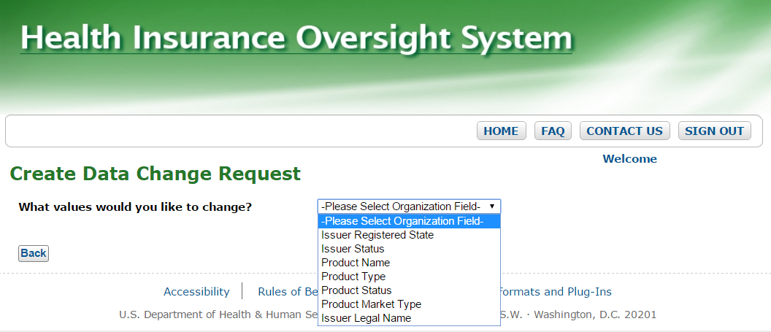
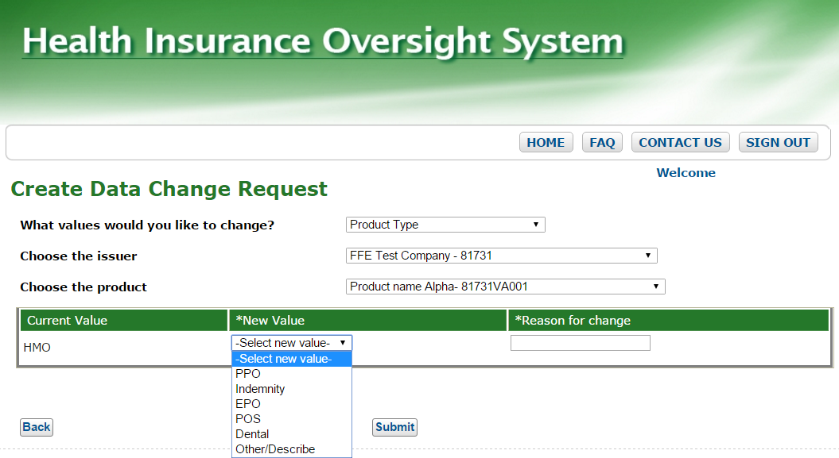
Issuer Administrators
Issuer administrators can submit data changes for fields related to Issuers and Products.
Following fields will be displayed in “What values would you like to change” drop down:
Issuer Legal Name
Issuer Registered State
Issuer Status
Product Name
Product Type
Product Status
Product Market type
Based on the value selected the drop downs for Choose the Issuer and Choose the Product are displayed for selection.
Select Values for Issuer or Product

Slide 21
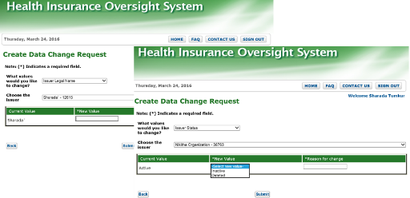
Issuer Administrators Continued
Depending on “what values would you like to change?” drop down selection, System will either display a text box or drop down to select the new values.
New Value
Is a Required field. Either a Text box or Drop down shall be displayed based on the Value selected for change.
Reason for Change
Is a Required field-Text box.(Max 250 characters) to submit the data change requests
A confirmation message will be displayed on submitting the change request.
New Value Text box and Drop Down Fields.
Confirmation Message screen

Slide 22
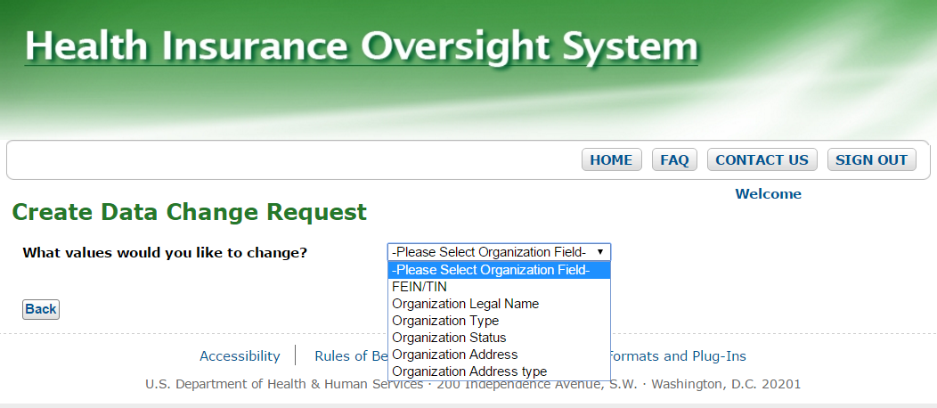
Organization Administrators
Following fields will be displayed in “What values would you like to change” drop down:
Organization type
Organization Status
Organization Address
Organization legal name
Organization Address type
FEIN/TIN
Depending on “what values would you like to change?” drop down selection, System will either display a text box or drop down to select the new values.
Select Values for the Organization
New Value Text box and Drop Down Fields.

Slide 23
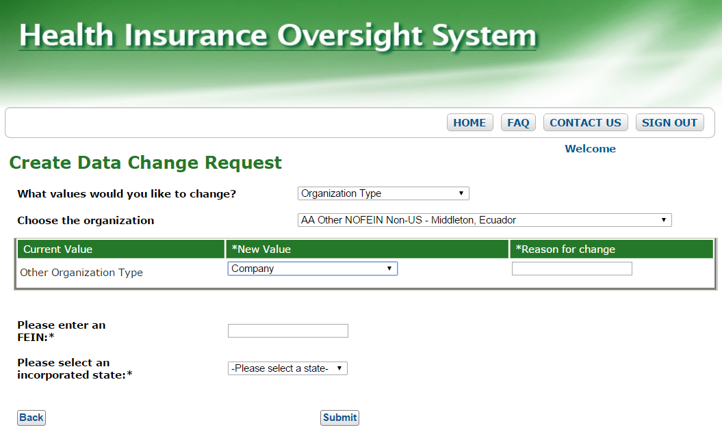
Organization Administrators: Special Scenarios
Incorporated State
To change an Organization Type from Non-Federal Governmental Plans to a Company or Non Insurance Company, you’ll need to select an additional attribute for incorporated state.
Other Organization to Company
To change Other Organization Type to a Company or Non Insurance, you’ll need to enter a FEIN if the Other organization type does not have one.
New Value
Is a Required field. The text box or Drop down shall be displayed based on the Change value selected.
Reason for Change
Is a Required field ,entered in the text box (Max 250 characters) to submit the data change requests
Other Organization Type to a Company

Slide 24
Confirmation Message Example
Confirmation Message:
A confirmation message with “Request ID” is displayed once the data request has been submitted.

Slide 25
Email Notifications for Data Change Requests Overview
Email Notifications for Data Change Requests: Administrator users will receive the following emails:
Request Completed Emails
Recipient: Data Change Request Creator (users with Company or Issuer or Org Admin roles) and CCIIO Approver User.
Trigger: Once the HIOS Data Management user has completed the Data Change Request, the Data change Request creator user will receive the email.
Request Unable to Process Emails
Recipient: Data Change Request Creator (users with Company or Issuer or Org Admin roles) and CCIIO Approver User.
Trigger: Once the HIOS Data Management user has Selected the UNABLE TO PROCESS THE REQUEST option, the Data Change Request, the Data change Request creator user will receive the email.
Request Denied Emails
Recipient: Data Change Request Creator (users with Company or Issuer or Org Admin roles).
Trigger: Once the CCIIO Approver user has completed Denying the Data Change Request, the Data change Request creator user will receive the email.

Slide 26
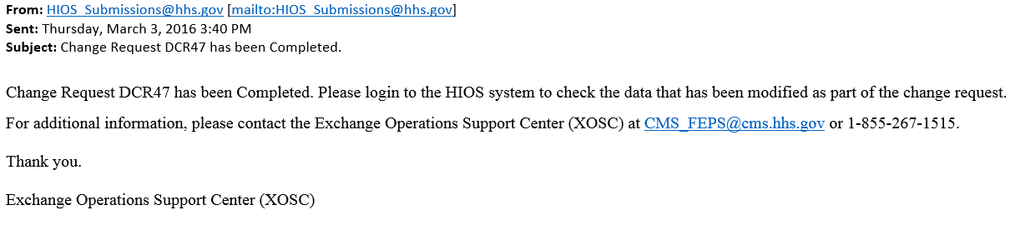
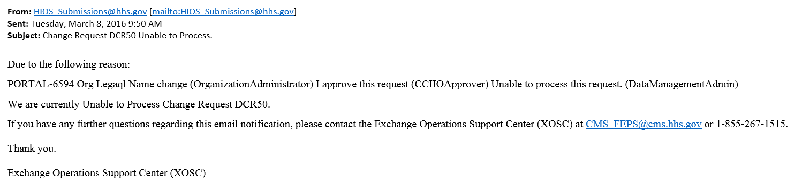
Email Notifications for Data Change Requests Examples
Sample Email Notifications Format
Completed Change Request Email Notification:
Unable To Process Change Request Email Notification:

Slide 27
Reference Documents
HIOS Portal Production Quick Guide
HIOS Portal “Manage Data Change Request” Quick Guide for Administrators
HIOS Portal User Manual

Slide 28

Questions

